Slide 1











2021
Heart
Failure
Prediction
Yap Chin Lok

Slide 2
Content
01
Introduction
02
Exploratory Data Analysis
03
Methodology and Result
04
Web Application
05
Mobile Application

Slide 3
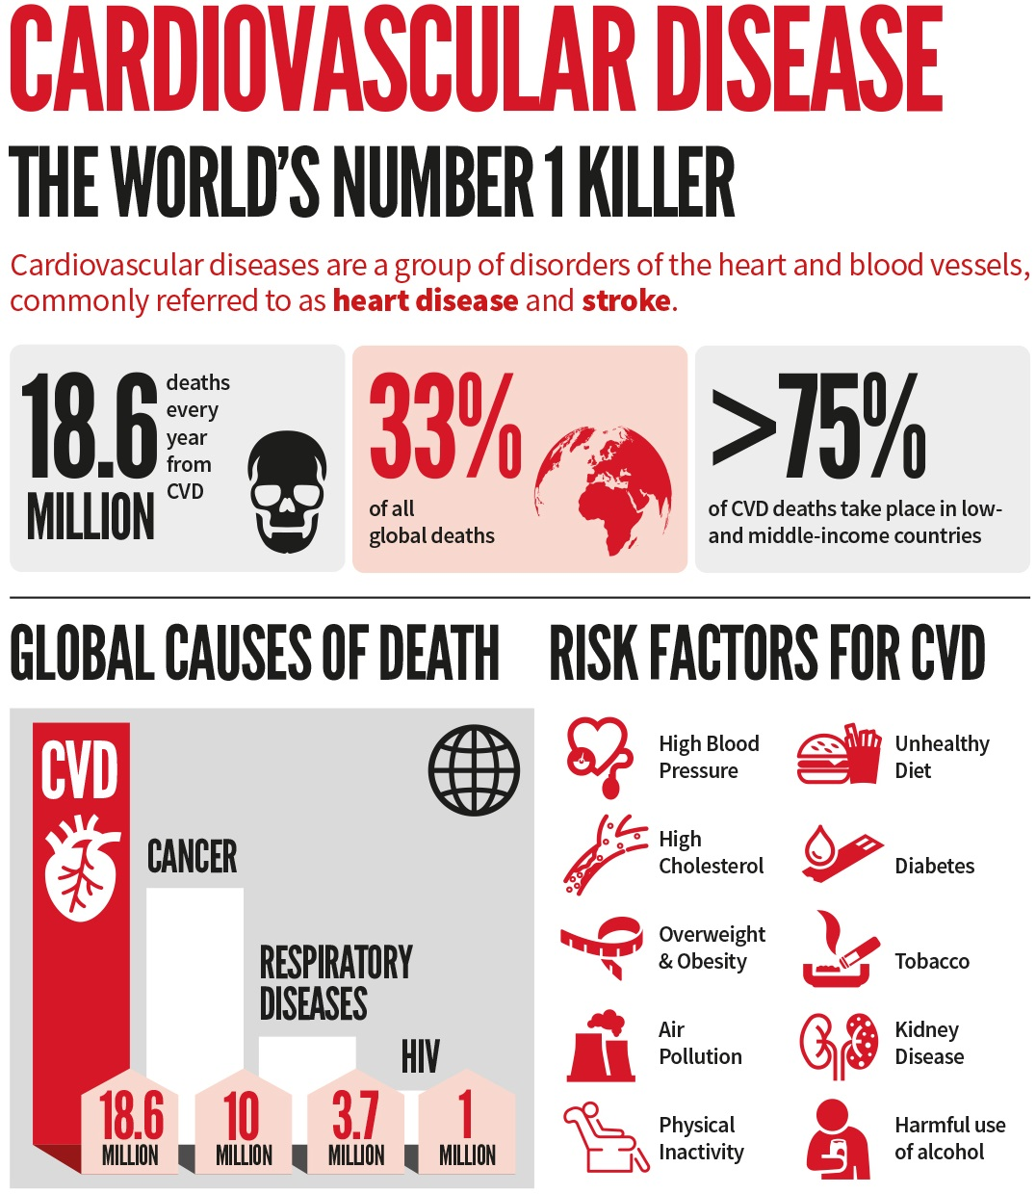
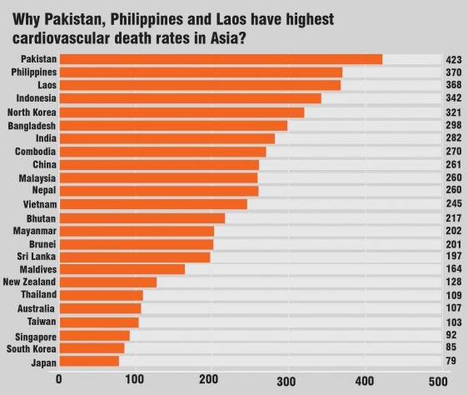
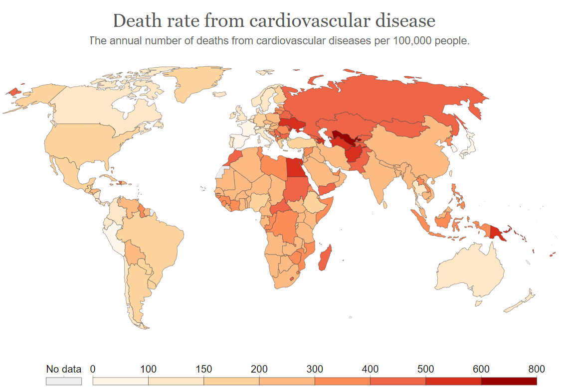
Introduction
Cardiovascular diseases (CVDs) are the leading cause of death globally. An estimated 18.6 million people died from CVDs in 2020, representing 33% of all global deaths.
85%
were due to heart attack and stroke!
Where?
How?
Solution?
Over three quarters of CVD deaths take place in low- and middle-income countries.
Most cardiovascular diseases can be prevented by addressing behavioral risk factors such as unhealthy diet, obesity, physical inactivity and other important clinical indications.
Therefore, it is important to detect heart diseases as early as possible so that management with counselling and medicines can begin.
World Health Organization, 2020
Health Analytics Asia, 2019

Slide 4
Objectives
To identify the best algorithm to be implemented in the diagnostic procedure.
To investigate and select the features that may potentially add value to the diagnosis analysis.
To deploy the trained model to both a web application and a mobile application to hasten the period of the diagnostic procedure.
Problem Statement
Heart diseases have been a serious health issue with an alarmingly high morbidity rate and an even higher mortality rate, reaching to a peak in 2020 with 18 million reported cases of heart diseases and compromising a third of global deaths.
In order to provide precise and accurate diagnoses, A.I. have been implemented into the diagnostic procedures of heart diseases in hopes of improving the overall quality of performance.
However, not much efforts have been contributed in the identification of the best algorithm along with the most potent features to be used for analysis.

Slide 5




Project Roadmap
Model Re-implementation and performance re-evaluation
Vision
Exploratory Data Analysis
Performance Evaluation
Start
Web Application
Mobile Application
Data Collection
Machine Learning + Deep Learning implementation
Feature Evaluation and Re-selection
Heat Failure Dataset (From UCI Machine Learning Repository)

Slide 6
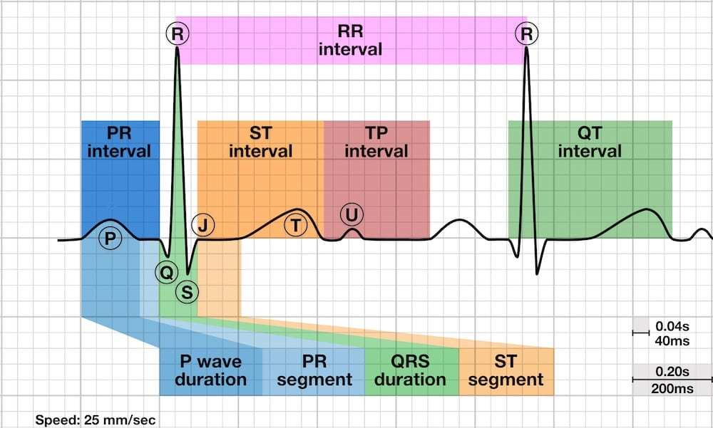
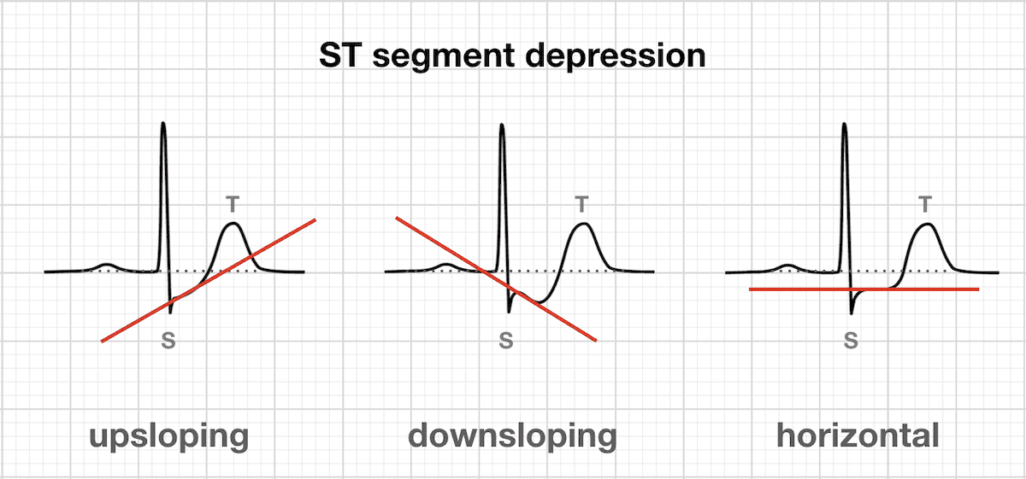
Features
There are 11 features encompassing 6 categorical features and 5 continuous features with a binary output of whether the patient is diagnosed with heart failure with 1190 instances.
Resting ECG
(Normal, ST Segment Abnormality, Left Ventricular Hypertrophy)
Cholesterol
Diabetic
Age
Exercise-induced Angina
Features
Sex
Slope and ST Depression
Maximum Heart Rate
Chest Pain Type
Resting Blood Pressure

Slide 7
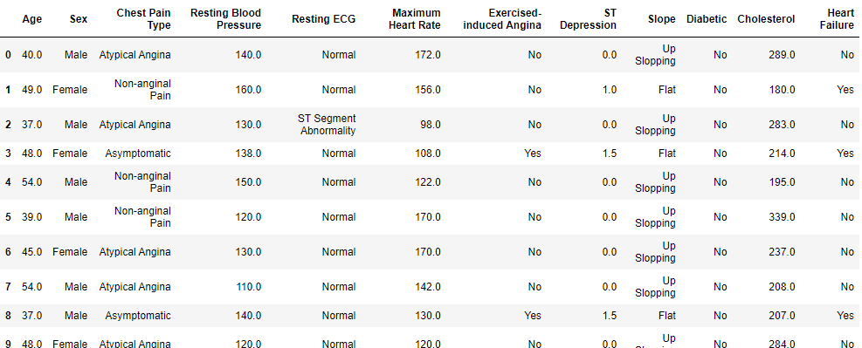
The Dataset

Slide 8
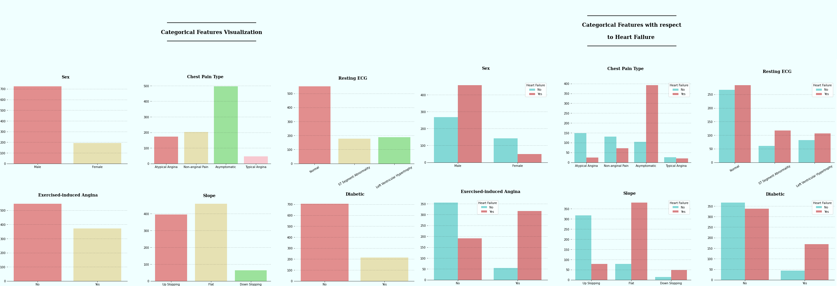
Exploratory Data Analysis
There were more than twice in Male patients than Female patients
Chest Pain Type could be a potential clinical indication of Heart Failure albeit having greater complications since the underlying cause of angina could have plentiful varieties!
Interesting enough, asymptomatic pain appeared to have the highest risk of heart failure.
Resting ECG might not be a good clinical indication in this case as not much is know about the reading (leads that are present with abnormalities were missing!)
All 3 classes had almost the same risk of heart failure, making it hard to make predictions based on this criterion!
Ischemia is extremely likely to be the root cause if the ST segment is Down Slopping, which in accordance which the data there are only very few reported cases of Down Slopping ST segment, making it more complicated to identify the presence of heart failure.
Interestingly enough, Up Slopping and Flat ST depression are reported predominantly.
Another additional fact to add value to the prediction model is that Up Slopping is largely a normal finding in strain test exercises, provided that the T Wave is NOT inverted. Even mere hyperventilation could cause similar up slopping, thus making modelling complicated to be based on this criterion without information on the T Wave.
However, it seemed that patients with Up Slopping ST Segment were likely to have heart failure whereas patients with Flat ST Segment are very unlikely to have heart failure, making this an ideal criterion for heart failure detection.
Diabetes is notably a poor clinical indication as non-diabetic patients has almost equal risk of heart failure.

Slide 9
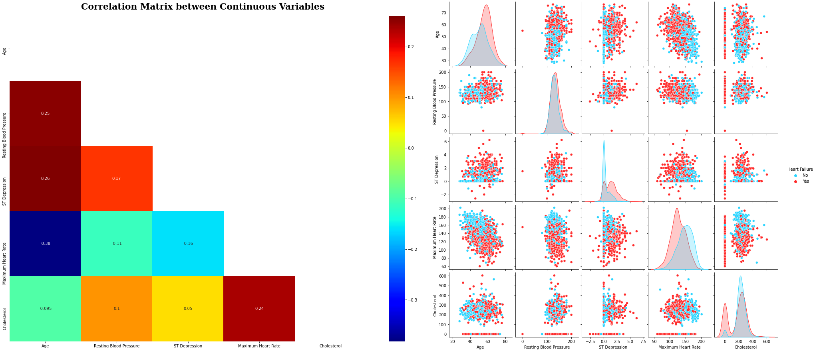
Exploratory Data Analysis
It is counter-intuitive to have elderly having lower risk of heart failure as elderly over the age of 60 reportedly having less risk of heart failure!
Resting blood pressure and cholesterol may potentially be a poor clinical indication as the risk of heart failure is almost the same.
ST Depression showed a trend in which a smaller depression in the ST segment Depression would typically present a greater risk of heart failure, much to our counter-intuition.
In addition to that, the specific lead on which this observation was made was not mentioned, the usability of this feature thus remained questionable!
Maximum Heart Rate achieved after exercise could potentially be a great clinical indication as it is intuitive that higher heart rate may have a higher chance of over-exerting the heart and resulting in internal haemorrhage from ruptured coronary arteries!

Slide 10
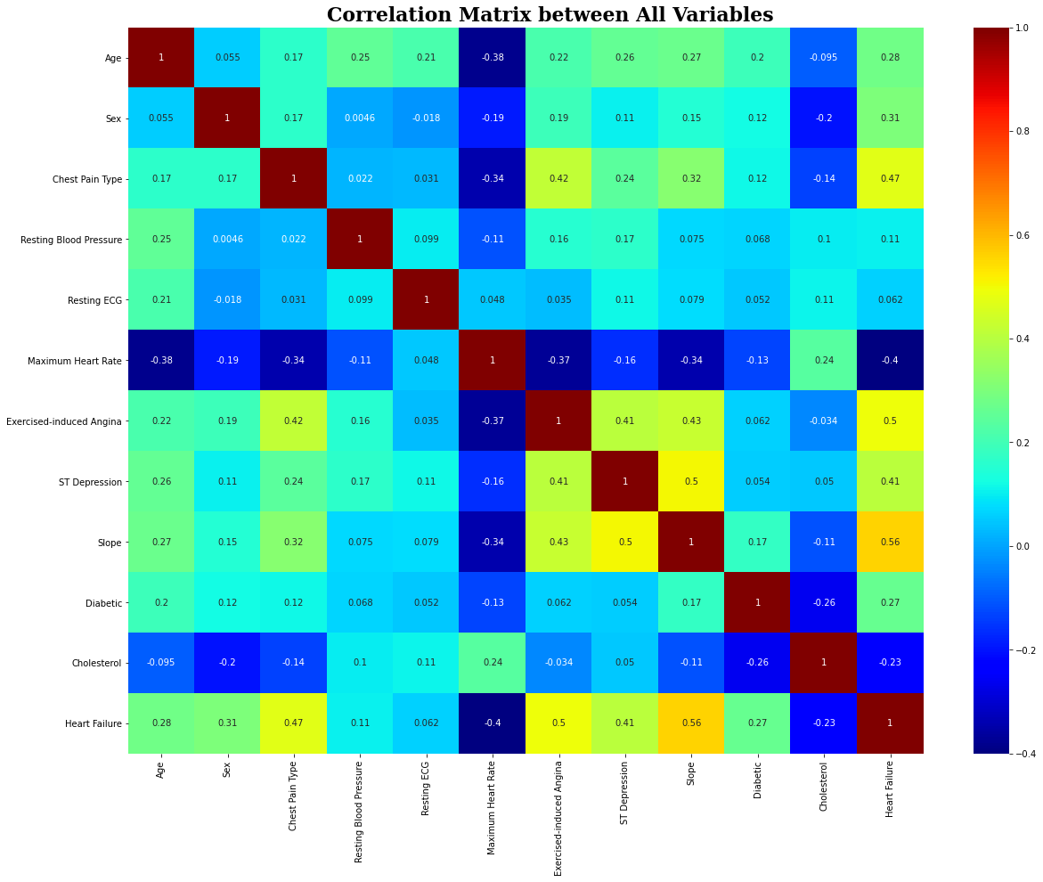
Exploratory Data Analysis
The correlation matrix on all variables reveal the potential correlation between Heart Failure and Exercise-induced Angina, Chest Pain Type, Maximum Heart Rate, ST Depression and Slope.
There was no apparent linear correlation between the continuous variables according to the heat map.

Slide 11
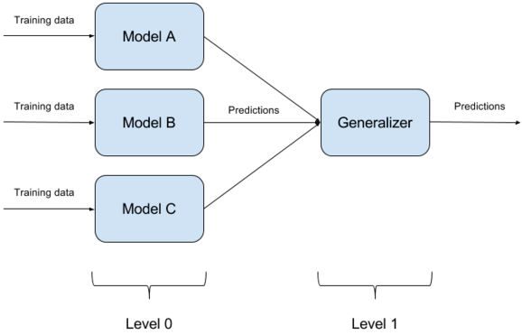
Methodology
Stacked Ensemble
Level 0 Basic Learner
(The Ensemble)
Logistic Regression
K Nearest Neighbor
Naïve Bayes
Decision Tree
Extra Tree
Random Forest
SVM Linear
SVM RBF
Adaptive Boost
Stochastic Gradient Descent
Gradient Boost
XGBoost
Multiple Learning Perceptron
Level 1 Meta Learner
Predictions
Multiple Learning Perceptron

Slide 12
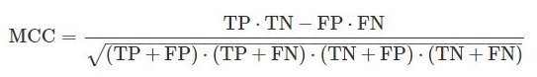
Performance Evaluation
A reliable statistical rate which produces a high score only if the prediction obtained good results in all of the four confusion matrix categories
True Negative Rate
Sensitivity
(Precision)
Specificity
(Recall)
F1 Score
Mathew Correlation coefficient (MCC)
Log Loss
True Positive Rate
Weighted average of Sensitivity and Specificity
Measures the performance of classification model where the prediction input is a probability value between 0 and 1. Penalizes especially those predictions that are confident AND wrong!

Slide 13
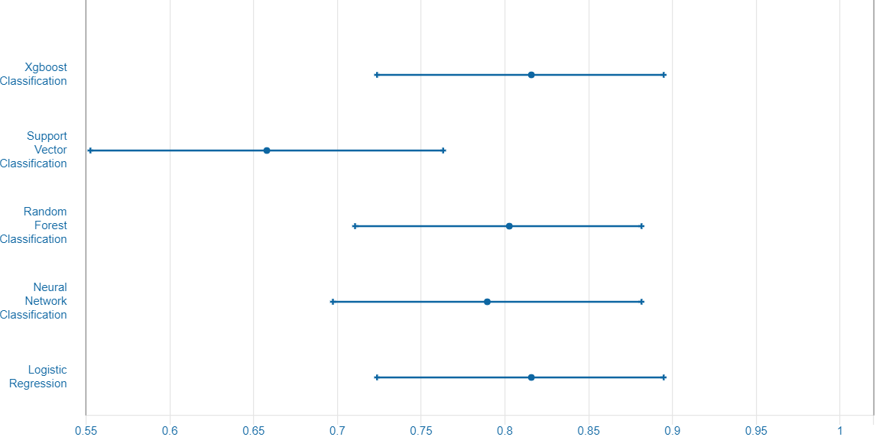
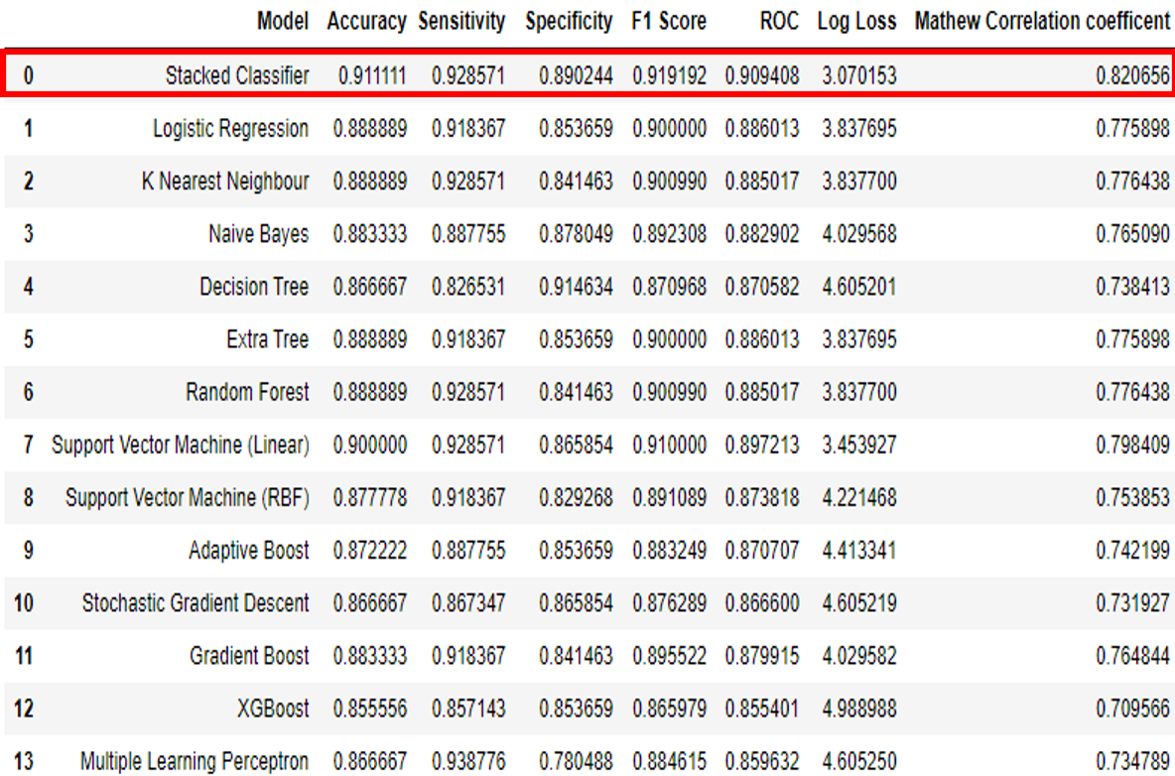
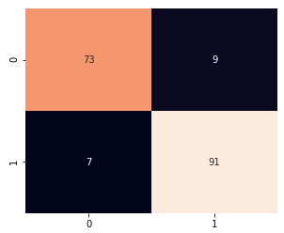
Model Evaluation
A Collection of past efforts
Stacked Classifier excels at every single evaluation!
UC Irvine Machine Learning Repository, 2021
Prediction
TN
FP
Actual
Confusion Matrix
FN
TP

Slide 14
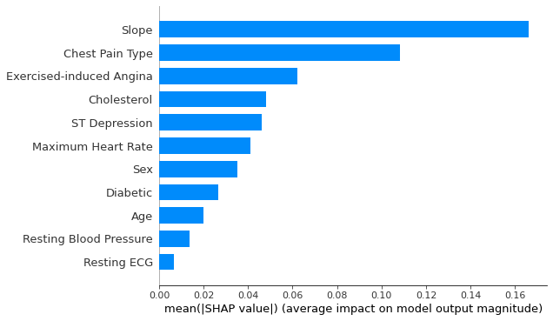
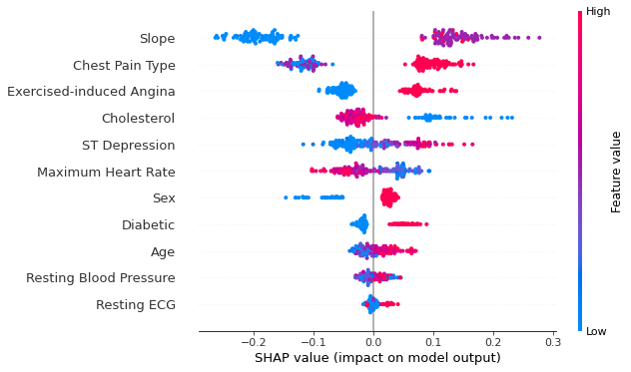
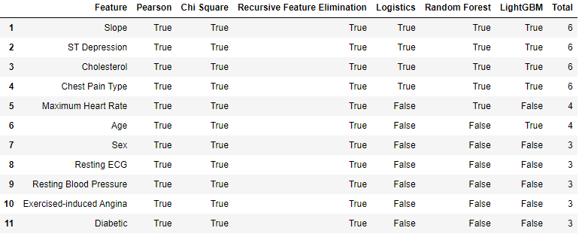
Feature Evaluation
The quality clinical indications discovered in this study include:
Slope
Chest pain Type
Exercise-induced Angina
Cholesterol
Sex
Features dropped:
Resting Blood Pressure
Resting ECG
Diabetic

Slide 15
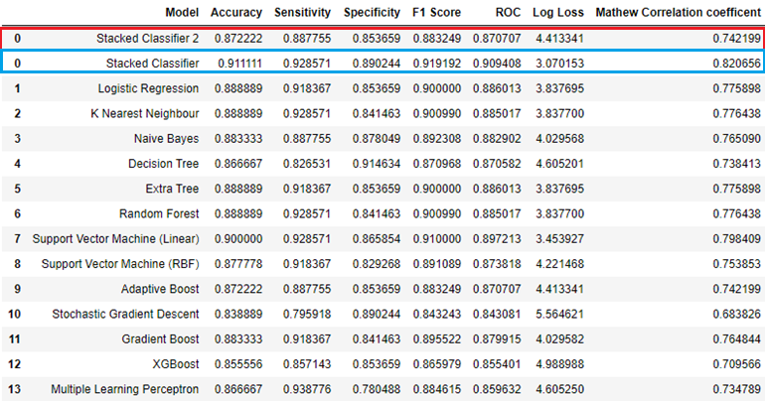
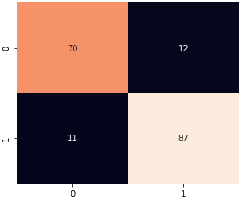
Model re-implementation and re-evaluation
Prediction
TN
FP
Actual
FN
TP
Confusion Matrix
Feature reselection didn't work as intended likely because it was due to the very limited number of features.
The removal of less-contributing features may result a drop in performance simply due to the sheer number of clinical indication being reduced!
If the dataset had a larger pool of features and more instances, feature reselection will conceivably yield a better result as the critical features retained may contribute more to the model and poor clinical indications removed would reduce the impact on the model.

Slide 16


Web Application
Hosted on Heroku
https://health-prediction-heart.herokuapp.com/
This is an essential precursor to the mobile app!!!

Slide 17

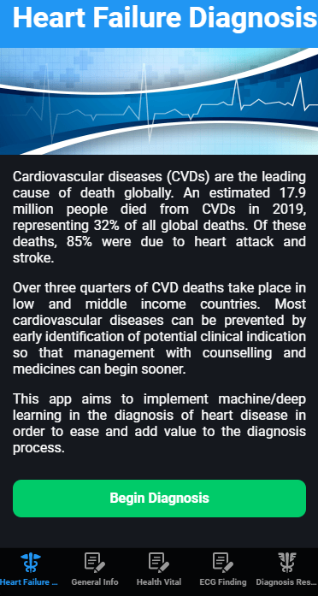



Mobile Application
Heart Failure Diagnosis App
The final goal of the project is to develop an app that not only simplify the process of diagnosis but also provide a valuable second opinion to doctors on the spot. In addition to that, it serves as a great tool to aid and train new doctors.
Glide App
Integromat
Google Sheet
The main Platform
The Web hook that connects Glide to Google Sheet
The API caller and the database
https://tired-street-7279.glideapp.io/

Slide 18

Overall, the Stacked Classifier with all of the features included scored the highest in all aspects, indicating the great potential of stacked ensemble algorithm in detecting heart failure!
01
Feature Re-selection didn’t work as intended possibly due to the limited number of features and instances. A larger dataset would potentially yield better result with conceivably higher performance quality as the meta leaners could gather more observations.
Conclusion
02
03
The deployment of machine learning model to web/mobile application is a success as they were all capable of analyzing and predicting heart failure based on the clinical indication inputs.

Slide 19
Thank You

Slide 20
References
Abdullah, A. S., 2012. A Data mining Model for predicting the Coronary Heart Disease using Random Forest Classifier. Recent trends in Computational Methods, Communication and Controls, ICON3C(3), pp. 22–25.
Almustafa, K. M., 2020. Prediction of heart disease and classifiers’ sensitivity analysis. BMC Bioinformatics, 21(278), pp. 1-18.
American Heart Association News, 2020. Heart disease, stroke death rates increase following decades of progress. [Online] Available at : <https://www.heart.org/en/news/2018/05/01/heart-disease-stroke-death-rates-increase-following-decades-of-progress> [Accessed 7 August 2021]
Inayati, N. K., 2019. Why are so many Asians dying due to heart diseases? [Online] Available at : <https://www.ha-asia.com/why-are-so-many-asians-dying-due-to-heart-diseases/> [Accessed 7 August 2021]
World Health Organization, 2021.Cardiovascular Diseases (CVDs). [Online] Available at : <https://www.who.int/news-room/fact-sheets/detail/cardiovascular-diseases-(cvds)> [Accessed 7 August 2021]
Fatima, M., Pasha, M., 2017. Survey of machine learning algorithms for disease diagnostic. J Intell Learn Syst Appl, 9(1), pp. 1.
Kota, P., Madenahalli, A., Guturi, R., Nukala, B. T., Nagaraj, S., Kota, S., Neeli, P. C., 2021. Heart disease classification comparison among patients and normal subjects using machine learning and artificial neural network techniques. International Journal of Biosensors & Bioelectronics, 7(3), pp. 77-79.
Marateb, H. R., Goudarzi, S., 2015. A noninvasive method for coronary artery diseases diagnosis using a clinically-interpretable fuzzy rule-based system. J Res Med Sci, 20(214), pp. 23.
Salhi, D. E., Tari, A., Kechadi, M. T., 2020. Using Machine Learning for Heart Disease Prediction. Advances in Computing Systems and Applications, 3(30), pp. 70-81.
Durairaj, M., Revathi, V., 2015. Prediction Of Heart Disease Using Back Propagation MLP Algorithm. International Journak of Scientific and Technology Research, 4(8), pp. 235–239.

